Slide 1
COUSINO EDITION
9TH GRADE SURVIVAL
GUIDE

Slide 2
DO YOU FEEL LIKE THIS?
THIS SHOULD HELP

Slide 3
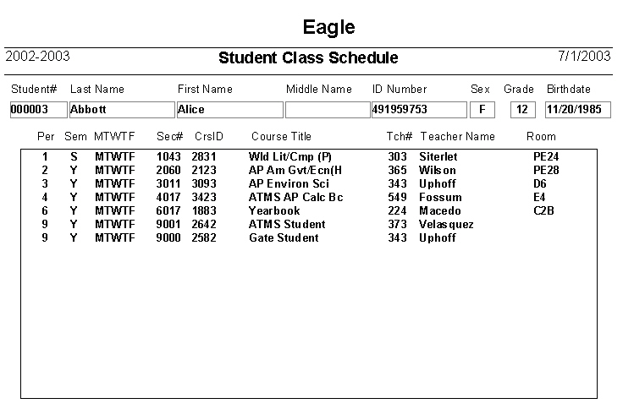
Take Out Your
Schedule
SNAP A PICTURE

Slide 4
MAKE IT YOUR WALL PAPER

Slide 5
NEXT
GETTING FROM
POINT A
TO
POINT B

Slide 6
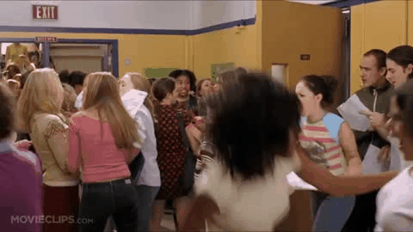
OBEY THE TRAFFIC LAWS
P
A
S
S
ON
T
H
E
L
E
F
T
S
T
A
Y
T
O
T
H
E
R
I
GH
T
DO NOT STOP IN TRAFFIC

Slide 7
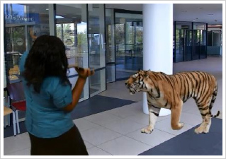
Don’t text
&
walk

Slide 9
THERE ARE NO
ELEVATORS, ESCALATORS, OR ESCAPE HATCHES.
THERE IS NO NORTH HOUSE but
THERE SHOULD BE
THERE ARE 3 HOUSES:
EAST
SOUTH
&
WEST

Slide 10
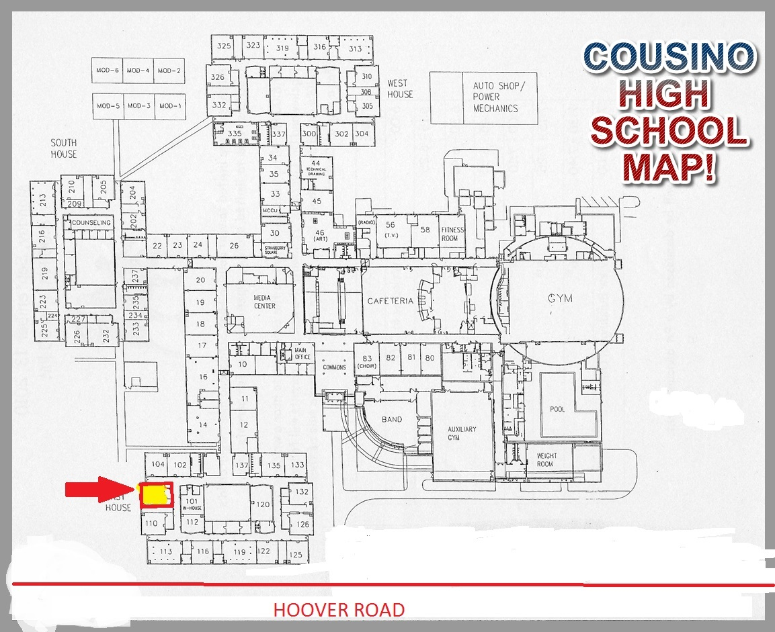
GIRLS BATHROOM
BOYS BATHROOM
EVERY HOUSE IS THE SAME SQUARE
HOUSE OFFICES

Slide 11
Cousino has 3 houses
East,
South,
and
West

Slide 12
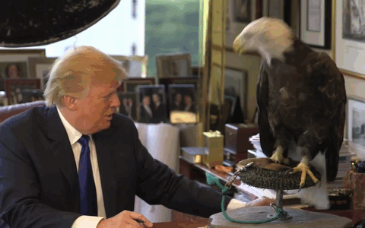
EAST HOUSE
LOST BOOKS
EAGLE
100’S

Slide 13
EAST HOUSE
Students
A-GN
MRS. PIROG

Slide 14
SOUTH HOUSE
COUNSELING OFFICE (schedules and stuff)
STATUE OF LIBERTY
200’S

Slide 15
SOUTH HOUSE
MRS. KUZICH
P-Z

Slide 16
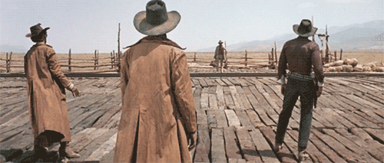
WEST HOUSE
WARRIOR
300’S

Slide 17
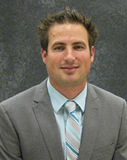
WEST HOUSE
GO-O
MR.
SHEPPARD

Slide 18
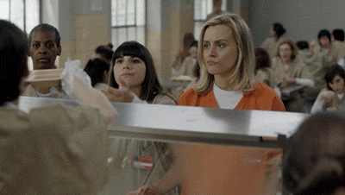
LUNCH
GET THERE QUICKLY
NO BAGS IN LINE
YOU CAN WEAR HEADPHONES
EVERYTHING IS ON CAMERA

Slide 19
IN THE CLASSROOM
CHECK IN FIRST
THEN GO TO BATHROOM OR LOCKER
TALK TO YOUR TEACHER
BEFORE OR AFTER CLASS

Slide 20
GRADES
Code TZDB
CHECK PARENT PORTAL DAILY- download the app NOW!
TALK TO YOUR TEACHERS:
ABOUT MISSING ASSIGNMENTS
QUESTIONS YOU HAVE
KEEP ALL YOUR WORK
TAKE NOTES
DO YOUR HOMEWORK!

Slide 21
There is NO Freshman Friday
Freshman Friday

